Slide 1


Chicago Traffic Analysis: Uncovering Trends for CTA Strategy
Chicago Transit Authority
Himamshu Chandrashekara

Slide 2

Objectives
When and where are crashes most likely?
What types of crashes are most likely?
Actionable insights for the CTA?

Slide 3

Overview
Traffic Crashes Dataset Overview:
37 columns, 786,386 rows.
Cleaned data from 2013.
Source: City of Chicago's Data Portal.
Key Columns for Analysis:
CRASH_DATE: Date and time of the crash.
POSTED_SPEED_LIMIT: Speed limit at the crash location.
TRAFFIC_CONTROL_DEVICE, DEVICE_CONDITION: Traffic control devices and their condition.
WEATHER_CONDITION, LIGHTING_CONDITION: Weather and lighting conditions.
FIRST_CRASH_TYPE: Type of the first collision.
TRAFFICWAY_TYPE: Type of trafficway.
CRASH_HOUR, CRASH_DAY_OF_WEEK, CRASH_MONTH: Timing of the crash.
LATITUDE, LONGITUDE, LOCATION: Geographical coordinates.

Slide 4
Temporal trends (time of day, day of week, and month) of traffic crashes in Chicago from 2013 to 2023.
Number of Crashes by Hour:
Lowest in early morning (2-5 AM).
Peaks in late afternoon and early evening (4-6 PM), aligning with rush hour.
Decreases in late evening and night.
Number of Crashes by Day of the Week:
Stable from Sunday to Wednesday.
Slight increase on Thursday.
Significant jump on Friday (start of the weekend).
Decrease on Saturday.
Number of Crashes by Month:
Lowest at the beginning of the year.
Steady increase, peaking in mid-year (warmer months).
Sharp increase in summer, potential peak travel season.
Decrease towards the end of the year.

Slide 5
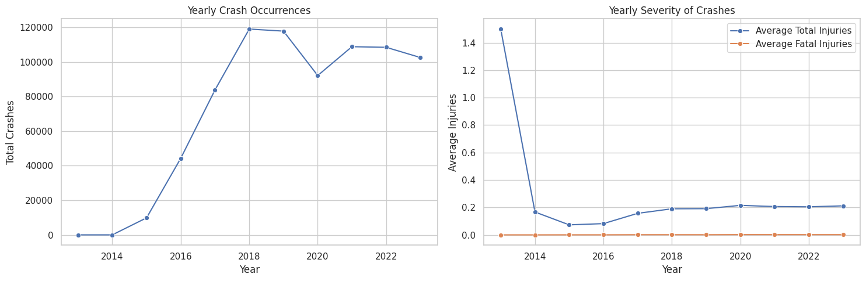
Yearly Crash Occurrences:
Inferences:
Significant increase from 2014 to 2018 (20,000 approx. to 120,000 approx. ).
Potential factors: increased traffic volume, altered patterns, or reporting changes.
Post-2018: Slight decline or stabilization.
Implications:
Understanding peak years crucial for targeted interventions.
Further investigation into contributing factors needed.
Yearly Severity of Crashes:
Inferences:
Average total injuries sharply decrease from 2014 (1.4) to under 0.5.
Fatal injuries per crash decrease, though less pronounced.
Stabilization in subsequent years.
Implications:
Positive trend in road safety measures or emergency response.
Continuous monitoring vital for sustained improvements.
Overall Insight:
Notable spike in crashes around 2016-2017, peaking at 120,000.
Average total injuries per crash significantly decrease post-2014, indicating positive safety trends.

Slide 6
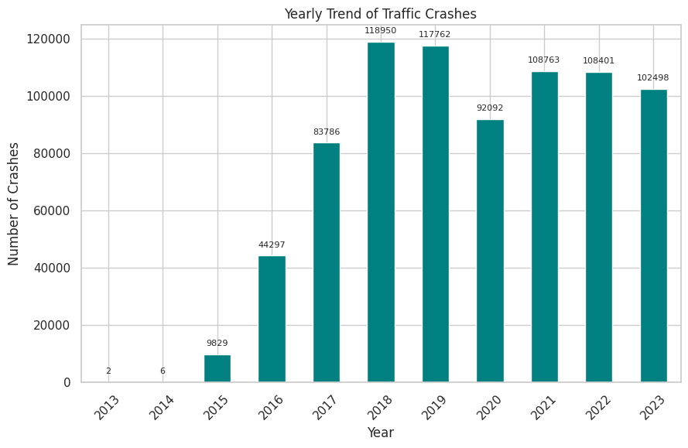
Yearly Trend of Traffic Crashes
Observation:
Upward Trend: Traffic crashes exhibit an ascending trend from 2015.
Peak in 2018: Reaches a zenith with nearly 120,000 crashes.
Post-2018: Slight decrease, maintaining levels around 100,000 to 110,000.
Interpretation:
Initial Increase: Addressed factors, halting the rise.
Persistent High Numbers: Possible ongoing issues in traffic management or urban planning.

Slide 7
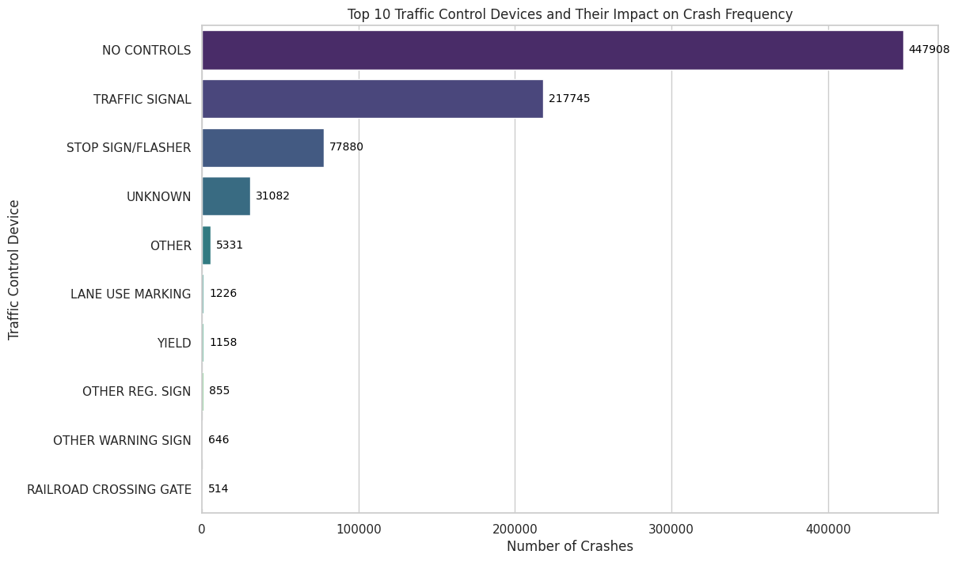
Top 10 Traffic Control Devices By Crash Frequency:
A lack of controls is associated with the highest number of crashes, with approximately 450,000 incidents, emphasizing the need for adequate traffic control measures.
Traffic signals are related to over 200,000 crashes, which may suggest issues with signal timing or driver compliance.

Slide 8
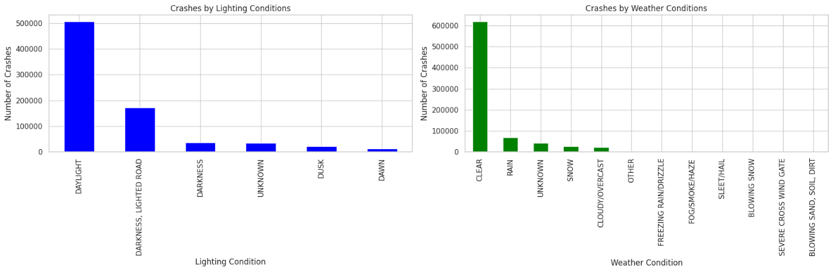
Most Traffic Crash Analysis by Lighting and Weather Conditions
Crashes by Lighting Conditions:
Daylight: Over 400,000 incidents.
Darkness without Street Lights: Approximately 150,000 crashes.
Crashes by Weather Conditions:
Clear Weather: Nearly 620,000 crashes.
Rain: Around 70,000 incidents.
Unknown: Approximately 70,000 crashes.
Snow: About 70,000 incidents.
Key Insights:
Daylight Incidents: High number indicates a correlation with increased traffic volume and better visibility during the day.
Darkness Impact: Significant number underlines the importance of street lighting for road safety.
Clear Weather Dominance: Majority of crashes occur in clear weather, hinting at potential factors like driver overconfidence or inattention.
Weather Influence: Rain, unknown, and snow contribute to a significant number of incidents, emphasizing the impact of weather conditions on road safety.

Slide 9
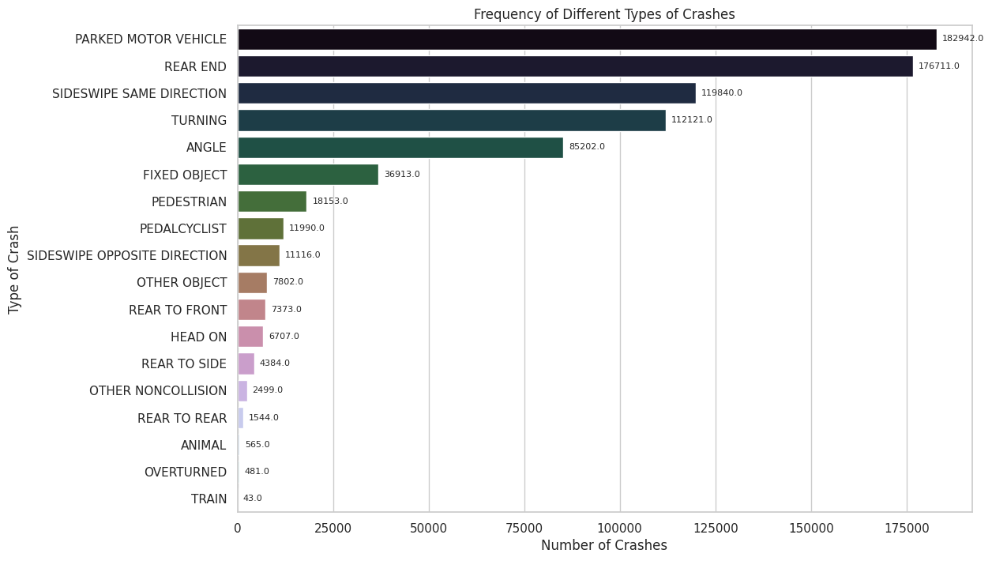
Top 5 Key Findings on Crash Types and Frequencies in Chicago
Parked Motor Vehicle Collisions:
Observation: Most frequent type.
Potential Issues: Street parking layouts, driver inattention, parking regulation.
Rear-End Collisions:
Observation: Second most common.
Potential Factors: Driver distraction, tailgating, traffic flow fluctuations, CTA stops.
Sideswipe Collisions (Same Direction):
Observation: Prevalent.
Possible Causes: Lane changing, merging, interaction with CTA buses.
Turning Accidents and Angle Collisions:
Observation: Common, especially at intersections.
Potential Challenges: Traffic signal timings, intersection design, driver behaviors.
Collisions with Fixed Objects:
Observation: Considerable.
Possible Links: Driver error, poor visibility, road design challenges.

Slide 10

Actionable insights for the CTA
The trends observed suggest several areas for potential improvement in CTA's operational zones. These include:
Enhancing parking regulations and street designs to prevent collisions with parked vehicles.
Implementing or improving public education campaigns focused on safe following distances and attentive driving to reduce rear-end collisions.
Reviewing and improving lane markings and signage to prevent sideswipe incidents.
Working with city planners to reevaluate intersection designs and traffic signal timings to reduce turning and angle collisions.
Increasing the visibility of CTA vehicles and improving pedestrian and cyclist infrastructure in heavily trafficked areas.

